Slide 1
Notes:
8min Motivation
Mesh-Up-Fähigkeiten für die eigene Plattform anbieten
Nutzer motivieren angebotene Services über das Web hinaus zu nutzen
Kreativität der Nutzer ausnutzen (Web 2.0 Gedanke)
Ihnen die Möglichkeiten geben großartiges mit deinen Services zu verwirklichen
Zum Nachdenken über eigene Services anregen
12min: InstantSVC Features, Überblick
Natürlich dürfen diese zusätzlichen Schnittstellen keinen Mehraufwand bedeuten
Wenn man das Anbieten von Web Services in der Architektur berücksichtigt führt das oft zu klarerem Design (stärkere Schichtung)
Kann auch für AJAX genutzt werden, als Basis für Web 2.0 Oberflächen ;)
werkzeuggestützte Entwicklung notwendig für effiziente Softwareentwicklung
Konfiguration statt Programmierung
10min: Vorstellung der Tools und Gimmicks, Call-Graphen als Eye-Catcher
15min: Einfaches Beispiel: Der Web Service für deinen Anrufbeantworter, Fernabfrage

Slide 2
Agenda
  Motivation
  Short Introduction to InstantSVC
  Live Demo: Adding a Web Service

Slide 3
Services?
  Blog with Web 2.0 Stuff
    Feeds, Publishing API, User Contribution, Single-Sign On,…
  Shops
    Catalog of Goods, Buying API, Availability Checks
    Intention: Close the Media Gap
  Enterprise Applications
    Finance, Warehouse Management, Human Resources,…
  Services provided by Specialists
    Used to build Applications upon

Slide 4
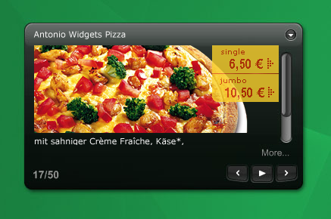
Services: For Whom?
Enterprise People
Innovators
  Portals and Mesh-Ups
    Personalization
    Single-Point-Of-Access
    Tools for there Employees
  Composite Applications
    Workflows for their Customers
    Quick and Cheap, but with convincing Quality
  It is cool
  Everybody wanne have
  Is it Flickr, del.icio.us, Digg, Google Maps, Ebay?
  Likely, it’s not!
  You did not imagine what's possible with your services
  They Do!
Notes:
Who did like to build Apps based on your services?
You don’t imagine, but you’ll make them pay for your services, so you’ll earn money and get something to eat.

Slide 5
The Core Web Services Protocol Stack
Discovery | UDDI (Itself a Web Service)
Description | WSDL, WSFL/XLANG, others to come
Access | SOAP, SOAP with Attachments, XML-RPC, REST
Transfer | HTTP, SMTP, FTP, others
Transport | TCP/IP, UDP, others

Slide 6
About the Project
  Developed by 6 HPI Students since October 2005
    Stefan Marr
    Christoph Hartmann
    Michael Perscheid
    Martin Sprengel
    Gregor Gabrysiak
    Falko Menge
  Project presented at the FrOSCon 2006
  Next Step: Contribution to eZComponents

Slide 7
InstantSVC Features/Components
  Extended Reflection API with Information about Types
  Annotations for PHP
  WSDL Generator conform to WS-I Basic Profile
  Document/Literal Adapter Generator
  Handler Chain Mechanism for SOAP Processing
  Implementation of WS-Security and Username Token Profile
  RESTful Web Services
  Administration Tool for convenient Creation und Management of SOAP and REST Services

Slide 8
Administration Front-End
  Administration Front-End
    Automated Creation of Web Services from existing Applications
    Annotations identify Classes to be used
    Administration via Web Browser
      Classes and Methods selected by User
      Generates SOAP and REST Server Scripts
      Generates WSDL File and Adapter Classes
      SOAP Server with WS-Security

Slide 9
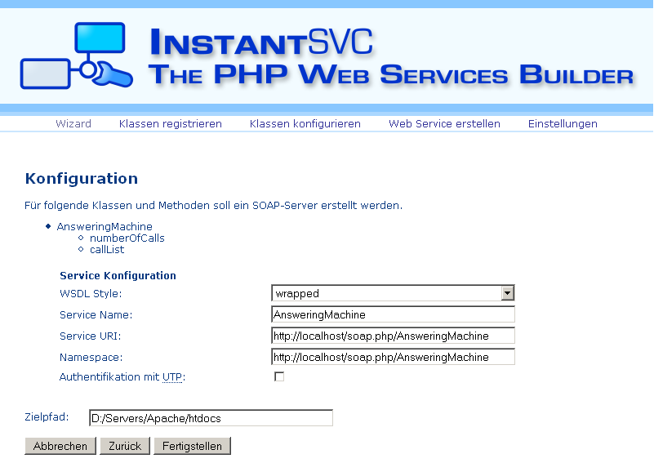
Administration Front-End

Slide 10
Components of InstantSVC

Slide 11
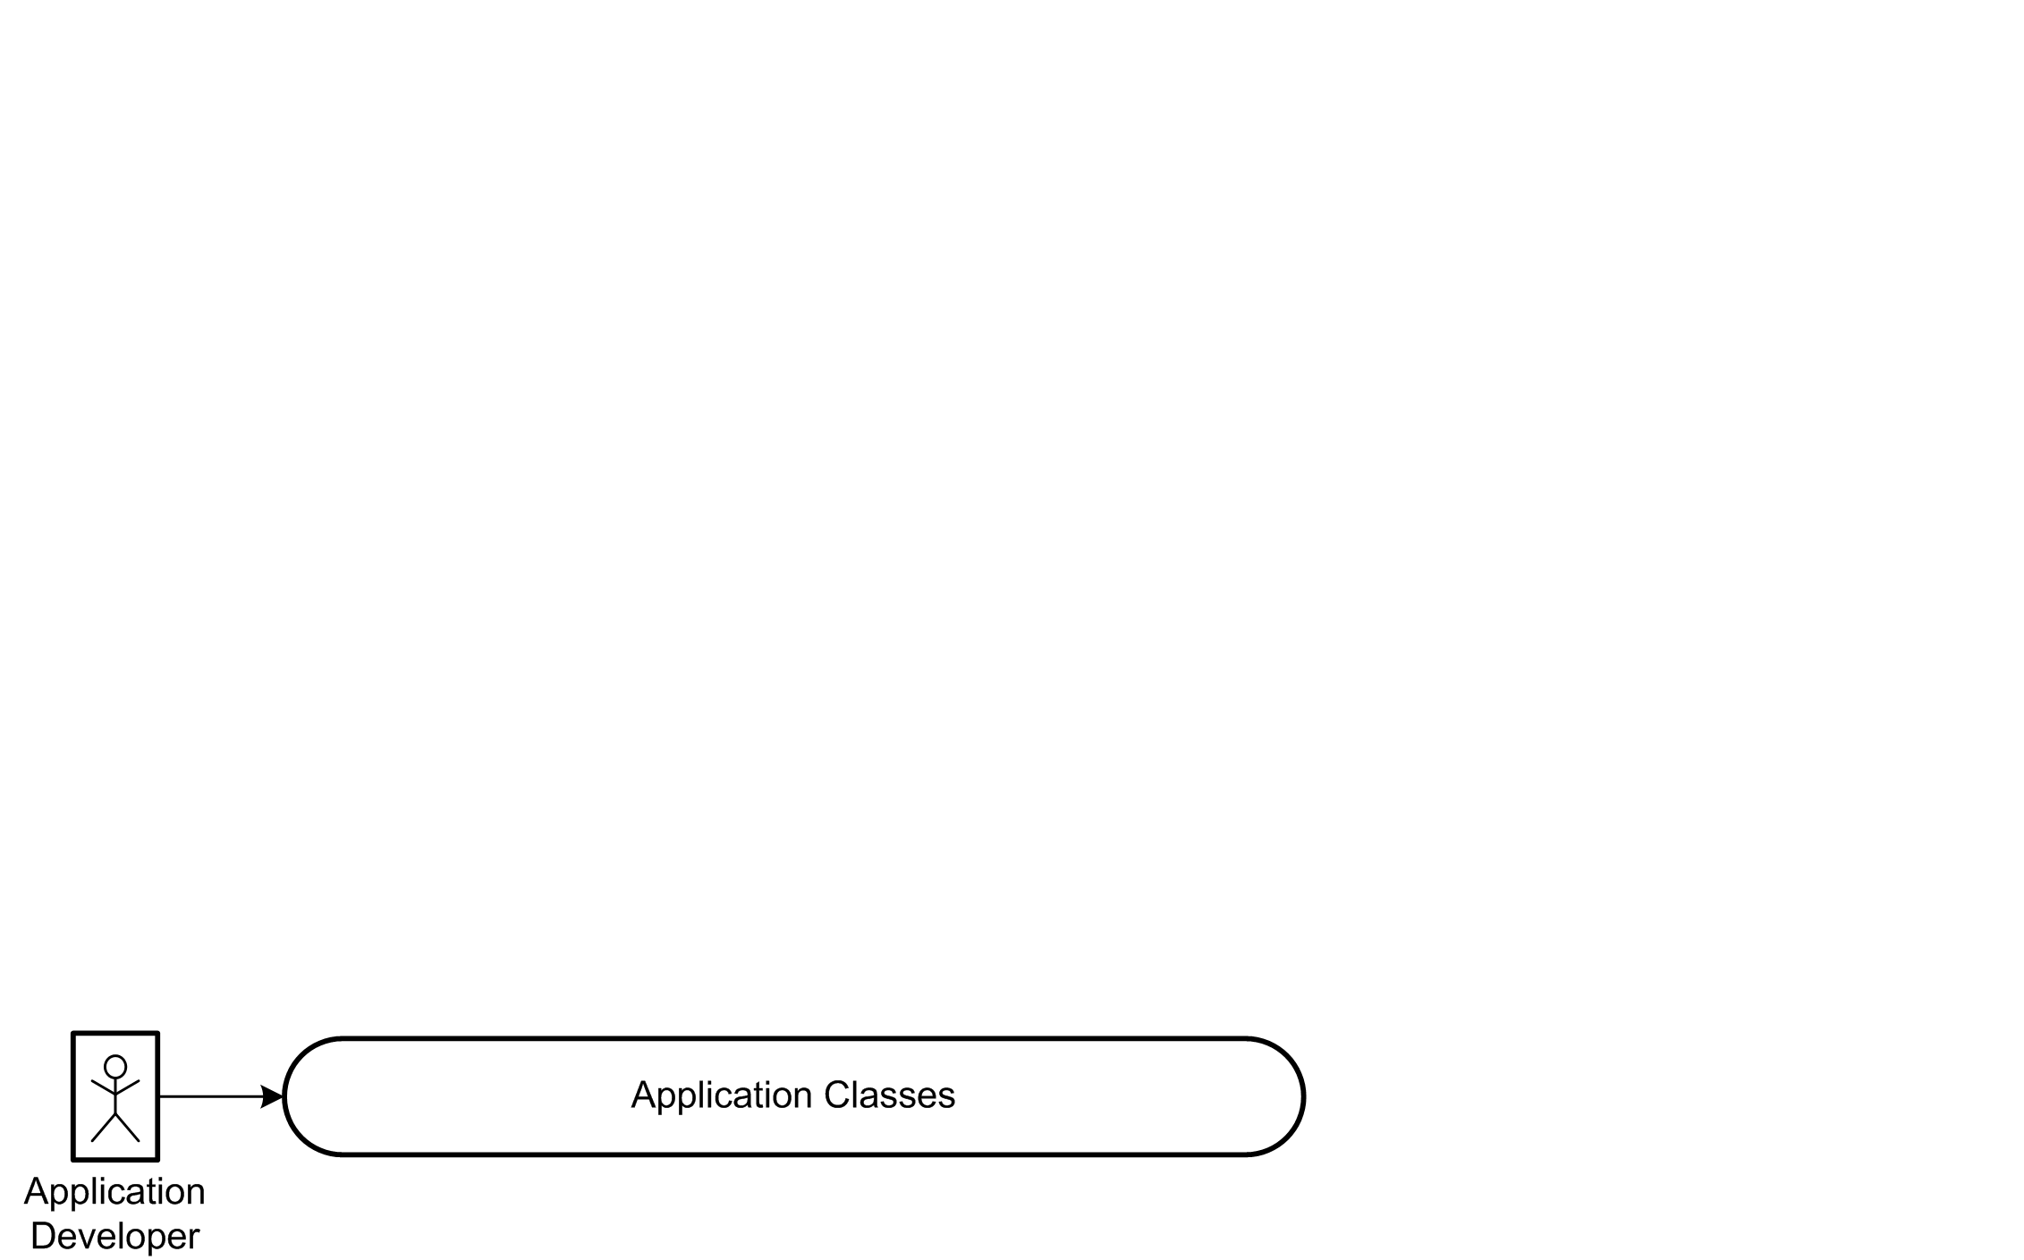
Interaction Overview

Slide 12
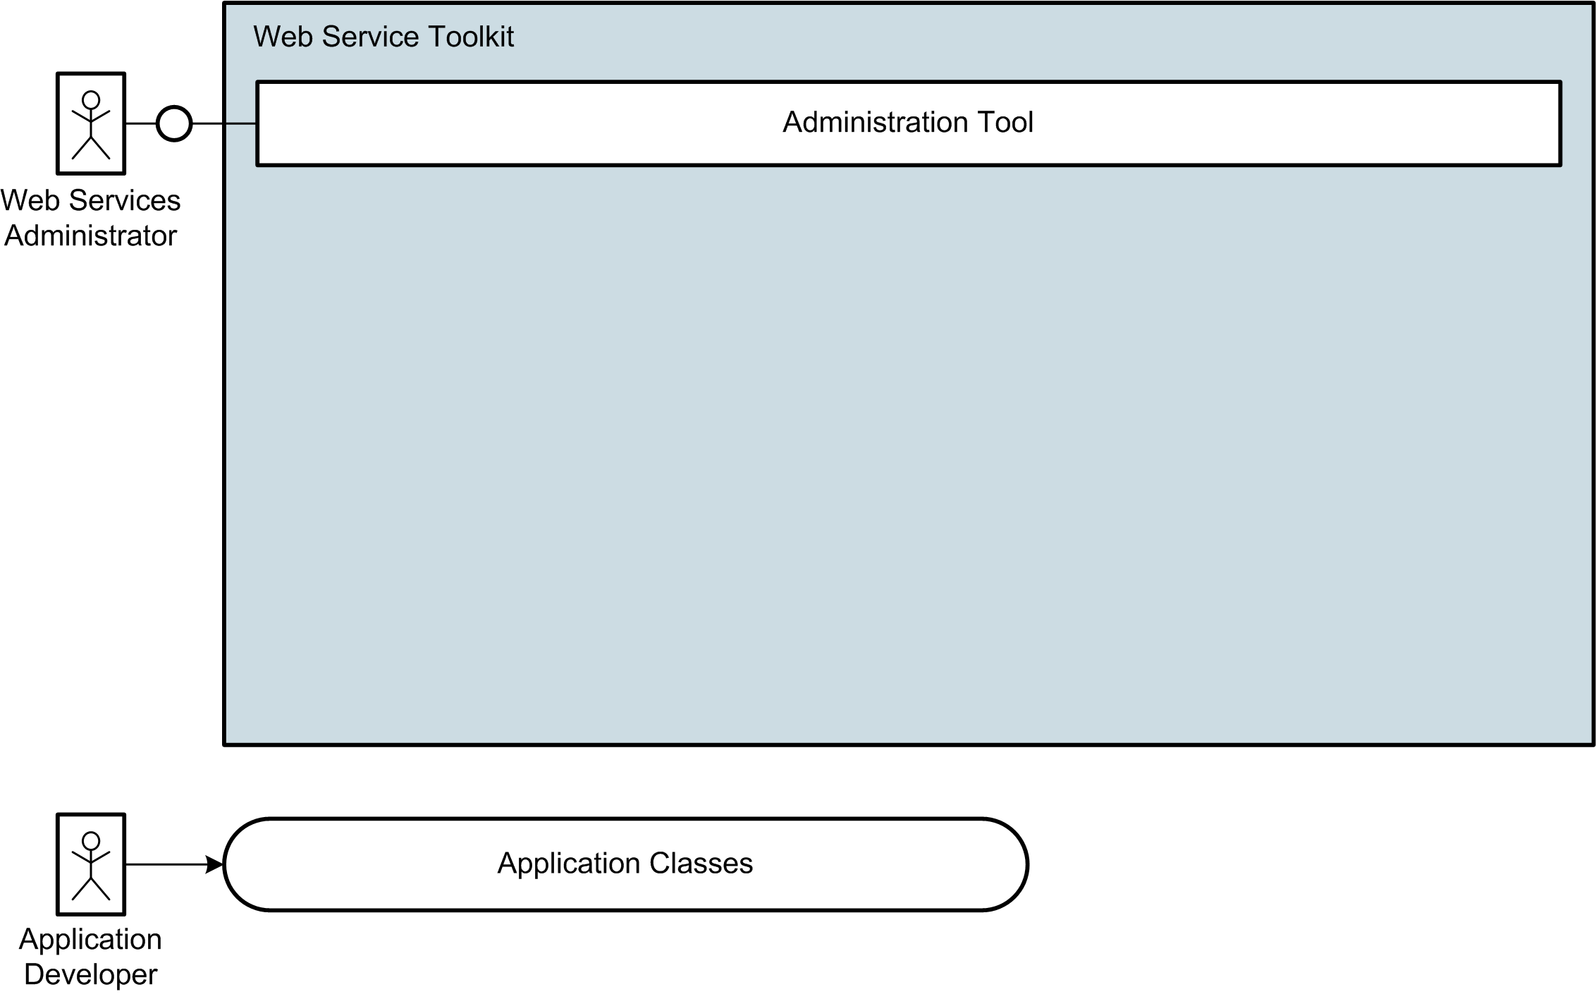
Interaction Overview

Slide 13
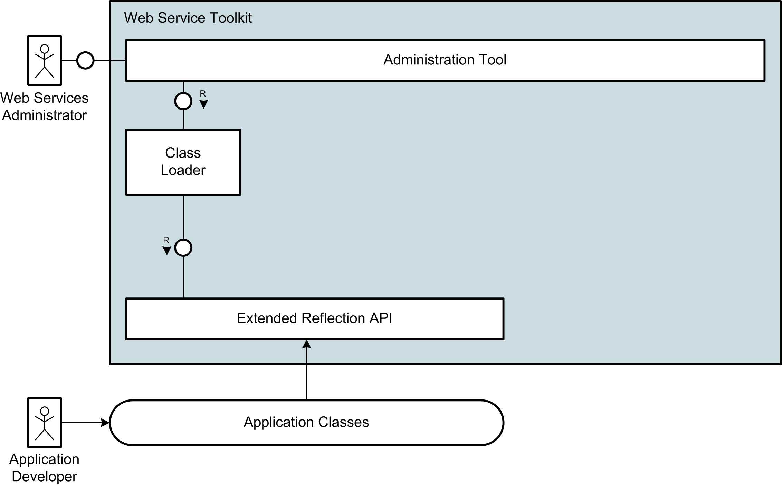
Interaction Overview

Slide 14
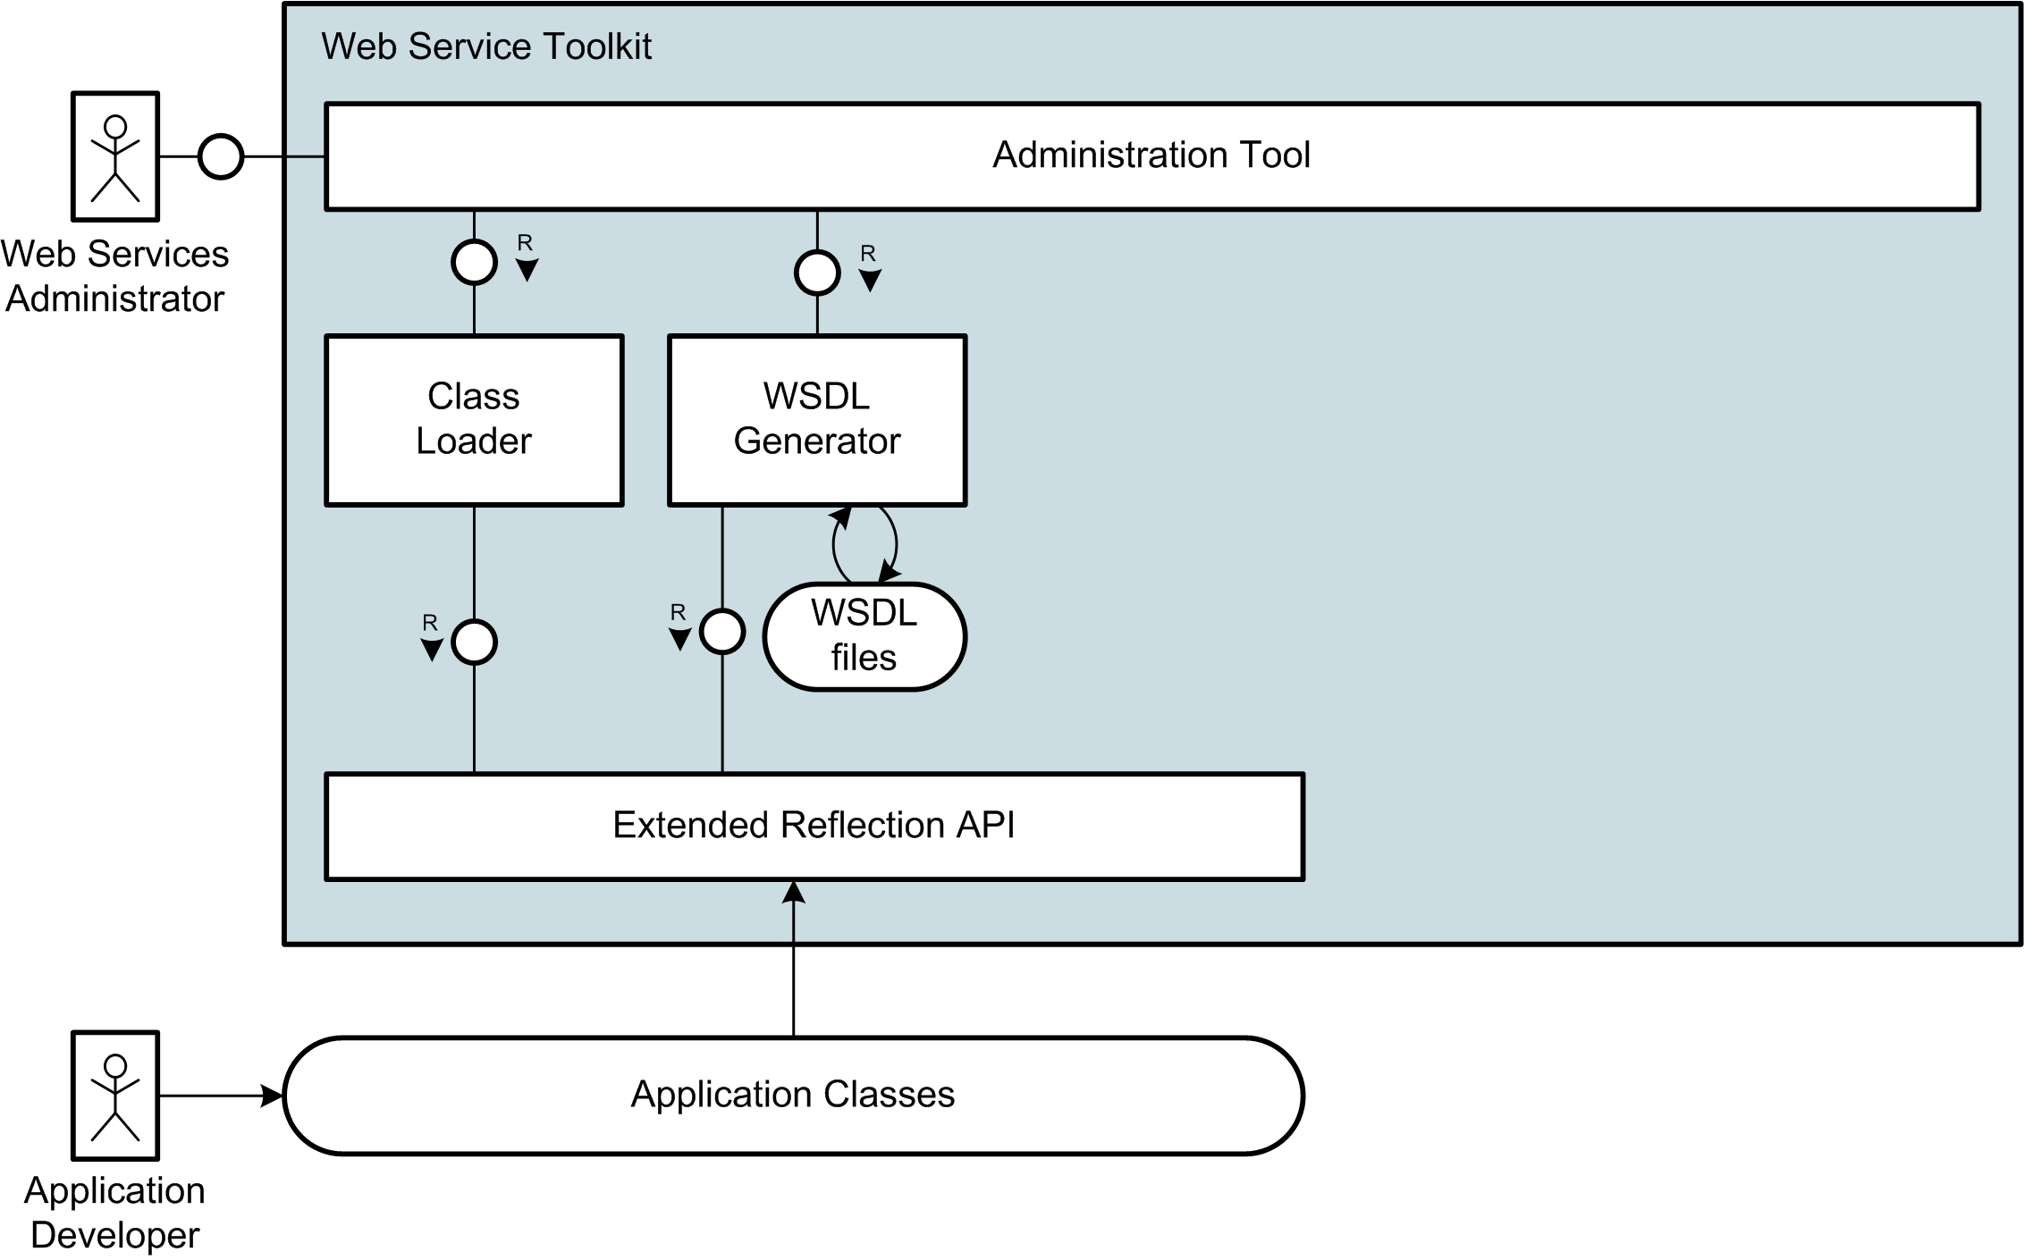
Interaction Overview

Slide 15
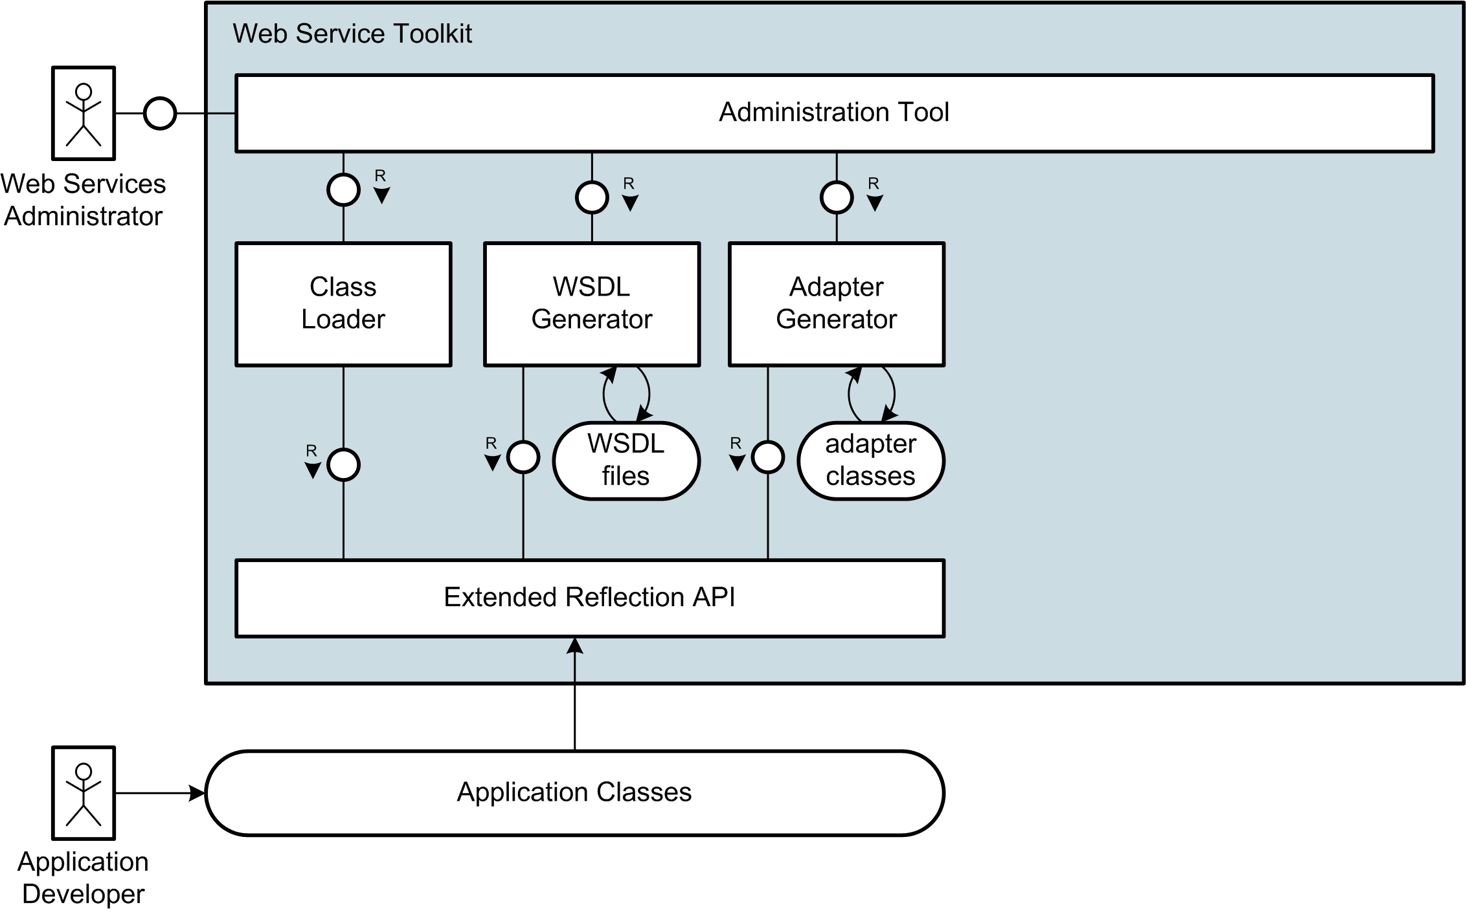
Interaction Overview

Slide 16
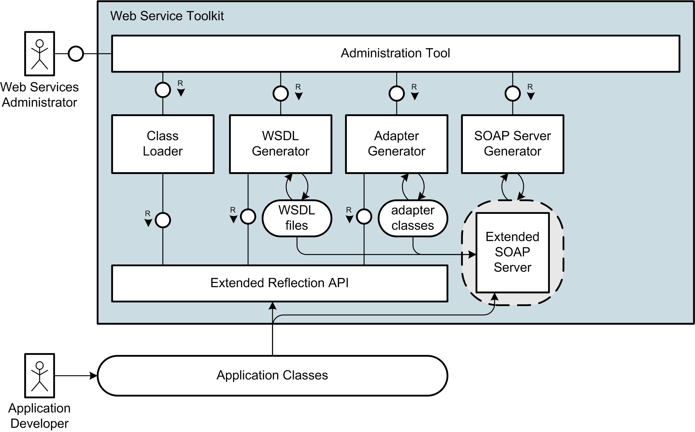
Interaction Overview

Slide 17
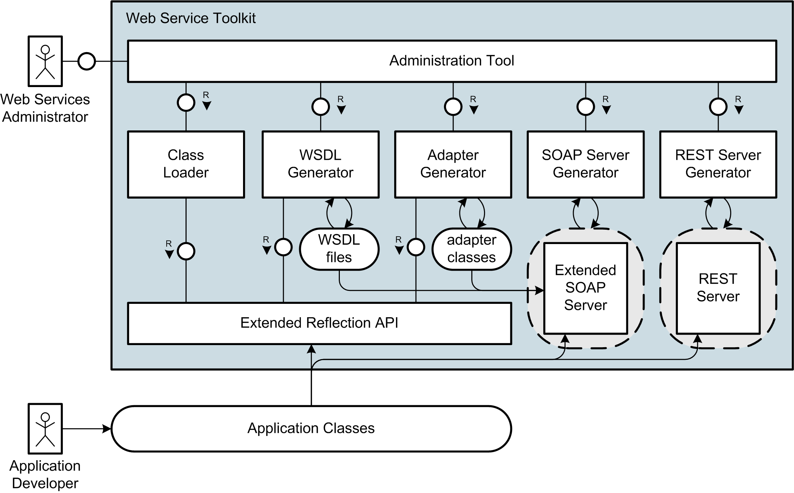
Interaction Overview

Slide 18
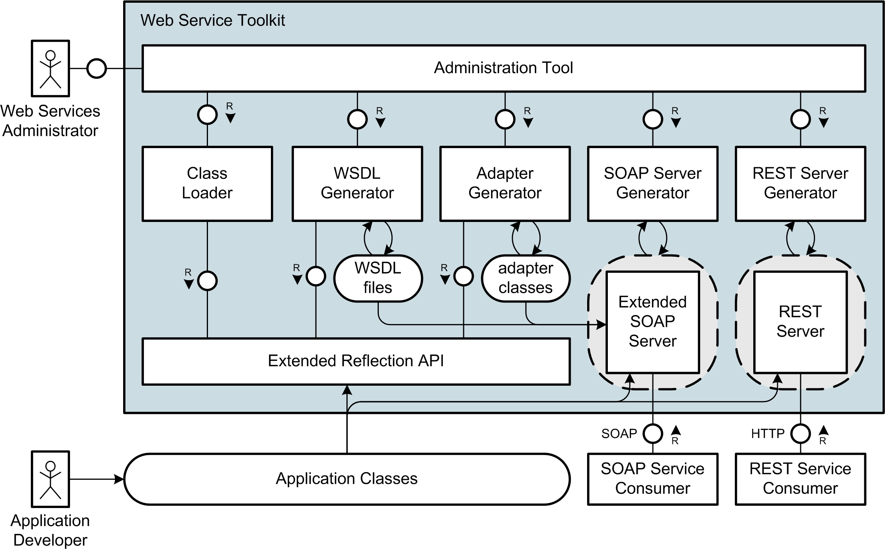
Interaction Overview

Slide 19
Live Demo

Slide 20
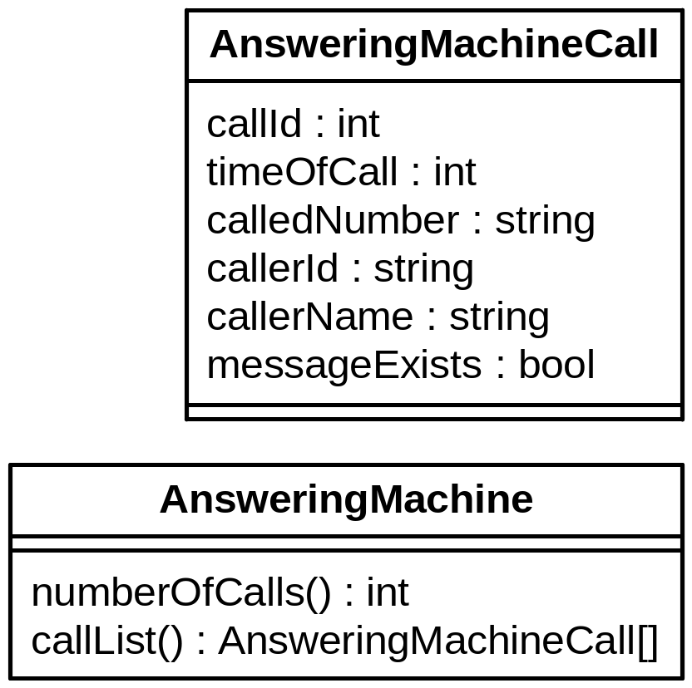
Live Demo

Slide 21
Example Application
  Application: Answering Machine
    Number of Calls
    List of Calls
  Example Web Service
    using SOAP Protocol
Notes:
Wichtige Punkt für solch einen Web Service
Gesichert durch Authentifizierung
Hier einfaches user/passwort
Je nach scenario vielleciht auch über client-zertifikate usw.
Notwendig einerseits für zugriffskontrolle
Andererseits fürs Abbrechnen der Zugriffe/Billing

Slide 22
Generation Steps
  Creating Web Services without Tool Support:
    Create XML Schema for Data Types
    Write WSDL Description
    Own Wrapping for Document/Literal
    Include Documentation
    Build SOAP Server Script
    No WS-Security Support
  InstantSVC automates all Steps

Slide 23
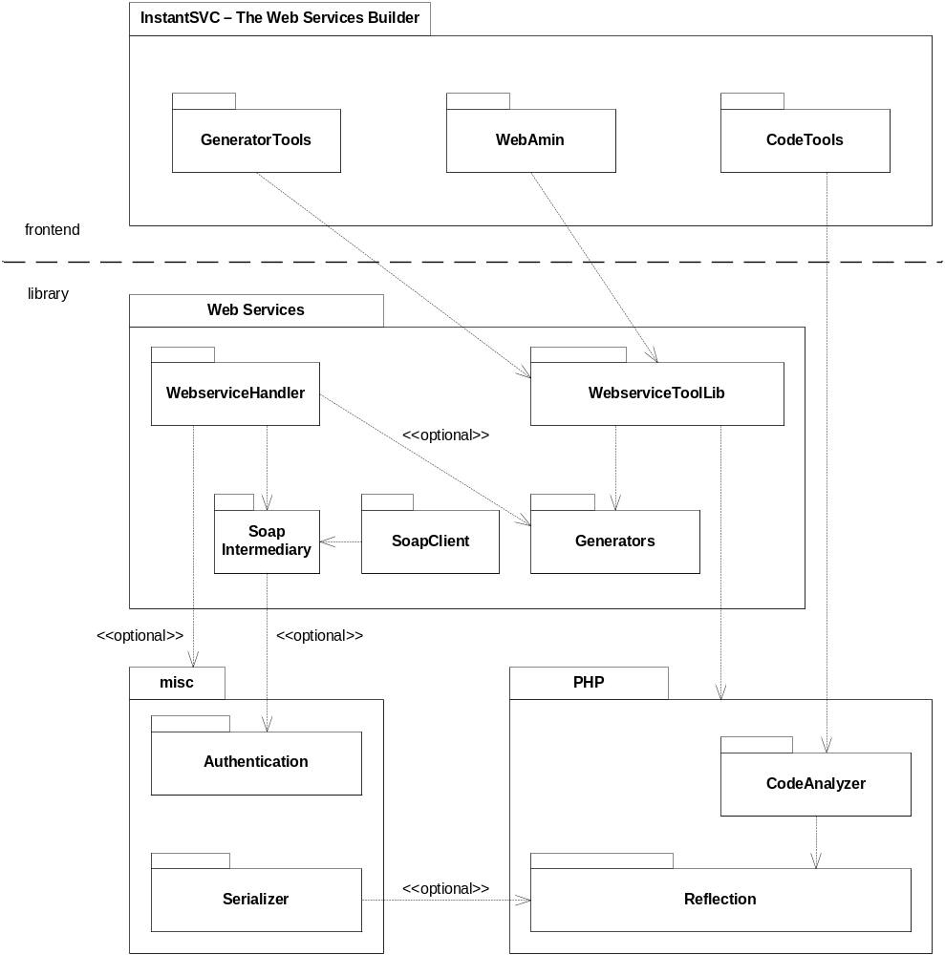
Components of InstantSVC

Slide 24
Summary

Slide 25

Further Information and Download at:
http://instantsvc.sourceforge.net

Slide 27
Suggested Reading
White Papers
[1] Einführung in XML Web Services, October 2005
[2] Web Services Facade for PHP5 – Konzeption, January 2006
[3] Web Service Toolkit für PHP5, March 2006
download at http://instantsvc.sf.net/
Further Sources
[4] RESTful Web Services, January 2006
http://www.stefan-marr.de/artikel/restful-web-services.html
[5] SOAP Version 1.2 specification, W3C Recommendation, June 2003. http://www.w3.org/TR/soap/
[6] Web Services Description Language (WSDL) 1.1, W3C Note, March 2001. http://www.w3.org/TR/wsdl/
[7] Username Token Profile 1.0, OASIS, January 2004
http://docs.oasis-open.org/wss/2004/01/oasis-200401-wss-username-token-profile-1.0.pdf

